Slide 1


Raghav Verma
14 January 2022

Slide 2

Outline
Executive Summary
Introduction
Methodology
Results
Conclusion
Appendix

Slide 3
Executive Summary
Data was collected by requesting from SpaceX API and by web scrapping launch records from Wikipedia. Once the data was collected, data Wrangling was done to format the data so that there are no missing values and all the relevant features are included.
Performed exploratory data analysis (EDA) using data visualization and SQL where we found out key findings like there are 4 unique sites for rocket launches, first successful landing in ground pad was achieved on 22/12/2015, different launch sites have different success rates with CCAFS LC-40 having a success rate of 60 %, while KSC LC-39A and VAFB SLC 4E has a success rate of 77%, maximum launches took place from site CCAFS LC-40, VAFB SLC 4E launch site is used only for light payload launches, orbits ES-L1,GEO,HEO,SSO have highest success rate of 100%, whereas SO has the lowest, and launch success rate( first stage will land successfully ) since 2013 kept increasing till 2020.
Performed interactive visual analytics using Folium and Plotly Dash where we found out that all the launch sites were located in close proximity of sea coast ~ 1km and equator , payload range of 200—4000 kg was associated with the highest successful landings, site KSCLC39-4 has the highest and largest successful landings.
Perform predictive analysis using classification models like Logistic Regression, decision tree, SVM, KNN. All the models have the same out of sample accuracy of ~83% i.e were able to predict landing outcome correctly.

Slide 4
Introduction
In a world where space travel is an upcoming thing, SpaceX has been outperforming its competitors by huge margin, primary reason behind this is that its rocket launches are relatively inexpensive by ~ 60% than its competitors. Much of this savings is because SpaceX can reuse the first stage of its rocket launches. So if we can predict whether the first stage of rocket will land successfully, we can predict the cost of the launch.
In this capstone we’ll determine if the first stage of the rocket will land, and subsequently find out the cost of the launch.

Slide 5


Slide 6
Methodology
Executive Summary
Data collection methodology:
Data was collected from SpaceX API and by web scrapping launch records from Wikipedia.
Perform data wrangling
Once the data was collected it was formatted so that there are no missing values and all the relevant features are included.
Perform exploratory data analysis (EDA) using visualization and SQL
Perform interactive visual analytics using Folium and Plotly Dash
Perform predictive analysis using classification models
How to build, tune, evaluate classification models

Slide 7
Data Collection
Data for the capstone was collected in two ways :
Sending requests to collect data from SPACEX API
Web scrapping data about launches from Wikipedia website
Processes have been explained in the following slides

Slide 8
Data Collection – SpaceX API
Request library in python was used to request rocket launch data from SpaceX API with the following piece of code:
spacex_url="https://api.spacexdata.com/v4/launches/past"
response = requests.get(spacex_url)
The above piece of code returned a JSON file which was then decoded using .json() method and converted into a dataframe using the json_normalize method.
The retrieved dataframe has a lot of the data as IDs. For example the rocket column has no information about the rocket just an identification number.
We will now use the API again to get information about the launches using the IDs given for each launch. Specifically we will be using columns rocket, payloads, launchpad, and cores.
We use the functions and respective API calls shown in the bottom half of the flowchart to perform the above task.
The end result will be a dataframe with the required values needed to take our research forward.
A URL of complete API calls notebook is being attached to have a look at the entire process of data collection via SPACEX API https://github.com/vermraghav/capstone-project/blob/f1ff7efd766c3f96bcce04d304af0450ca589f16/SpaceX%20Captsone%20Project.ipynb
#sending request to SPACEX API for data
spacex_url=https://api.spacexdata.com/v4/launches/past
response = requests.get(spacex_url)
Receive Json File
#functions with respective API calls that helped us use the API to extract information using identification numbers in the launch data.
getBoosterVersion() , getLaunchSite(), getPayLoadData(), getCoreData()
response=requests.get("https://api.spacexdata.com/v4/rockets/"+str(x)).json()
response=requests.get("https://api.spacexdata.com/v4/launchpads/"+str(x)).json() response=requests.get("https://api.spacexdata.com/v4/payloads/"+load).json() response=requests.get("https://api.spacexdata.com/v4/cores/"+core['core']).json()
# Use json_normalize method to convert the json result into a dataframe data=pd.json_normalize(response.json())

Slide 9
Data Collection - Scraping
BeautifulSoup was used to scrap the Falcon9 launch Wiki page webpage to collect the relevant data: https://en.wikipedia.org/w/index.php?title=List_of_Falcon_9_and_Falcon_Heavy_launches&oldid=1027686922
The above url was requested using requests.get( ) method as an HTML response then a BeautifulSoup object was created from the HTML response.
Next we collected all the relevant column names from the HTML header, for this we used find_all( ) method in BeautifulSoup to find all the tables in the HTML and choose the relevant table , after this we iterated through the headers of relevant table and extracted the desired columns.
Finally we created the dataframe by parsing the launch HTML table, for this a dictionary was created with keys similar to the extracted column names and was filled with launch records extracted from rows and converted into dataframe using pandas’ from_dict( ) method.
Here’s the link of the completed web scraping notebook to see the process in detail: https://github.com/vermraghav/capstone-project/blob/a9d5293dd1ac817a32754905d62c8dc6f6911451/data%20collection%20using%20webscrapping.ipynb
Request the Falcon9 Launch Wiki page from its URL
static_url="https://en.wikipedia.org/w/index.php?title=List_of_Falcon_9_and_Falcon_Heavy_launches&oldid=1027686922"
data=requests.get(static_url).text
soup=BeautifulSoup(data,"html.parser")
Extract all column/variable names from the HTML table header
Create a data frame by parsing the launch HTML tables

Slide 10
Data Wrangling
Filter Dataframe
Remove the Falcon 1 launches keeping only the Falcon 9 launches. Filter the data dataframe using the column to only keep the Falcon 9 launches. Save the filtered data to a new dataframe
Deal with the missing values
Mean value of payload mass was calculated and missing values were replaced by it across the dataframe
Convert Landing outcomes to training labels
Landing outcomes were converted to training variables 1 and 0 to represent successful and unsuccessful landing
Dataframe was filtered only to include Falcon 9 launches.
The missing values were replaced with the mean value of Payload mass.
Landing outcomes were converted to training labels with 1 and 0, where 1 represents that booster landed successfully and 0 represents it is unsuccessful.
Url for the data wrangling notebooks have been shared to see the detailed process and results:
https://github.com/vermraghav/capstone-project/blob/a9d5293dd1ac817a32754905d62c8dc6f6911451/SpaceX%20Captsone%20Project.ipynb
https://github.com/vermraghav/capstone-project/blob/3c3eefd58beee8d8b1c5bcd7836f7378ed2281a2/Data%20Wrangling.ipynb

Slide 11
EDA with Data Visualization
Summarize what charts were plotted and why you used those charts
Scatter point plot was used to visualize relationship between different variables against each other like flight number, payload mass , launch site, orbit type.
Bar chart was used to visualize relationship between success rate of each orbit type, as it is best used to track changes overtime and compare things.
Line chart was used to visualize success yearly trend as it is best used to track changes over a long period.
Here’s is the link for the detailed EDA with Data visualization notebook to see the process in detail. https://github.com/vermraghav/capstone-project/blob/0af4d89819327c0be1c08159630fb9a924e8f3cb/EDA%20with%20pandas%20and%20matplotlib.ipynb

Slide 12
EDA with SQL
The following SQL queries were performed as a part of EDA:
Unique launch sites were identified.
Total payload mass in kg carried by boosters launched by NASA(CRS)
Find average payload mass in kg carried by booster version F9 v1.1
Find the date on which the first successful landing outcome in a ground pad was achieved
Find booster versions with mass in the range between 4000kg and 6000 kg that successfully landed on a drone ship.
List the total number of successful and failure mission outcomes.
Identify booster versions that carried the maximum payload mass
Rank the landing outcomes based on count between 4 June,2010 and 20 March,2017 in descending order.
URL of the completed EDA with SQL notebook is been shared for reviewing the detailed process.
https://github.com/vermraghav/capstone-project/blob/8915c709dd65123484571a0d314989995fe2b224/EDA%20with%20SQL%20Lab.ipynb

Slide 13
Build an Interactive Map with Folium
Summarize what map objects such as markers, circles, lines, etc. you created and added to a folium map
Circle markers were added to the map to represent the launch sites and be NASA Johnson Space Center at Houston, Texas.
Clusters were created along with red and green circle markers to mark the failed/success launches for each sites.
A marker with Icon anchor was created with distance label to represent the sea coast line from the launch site CCAFS SLC-40
A distance line was created to see the proximity between two launch sites, sites and coast.
Sharing link for the completed interactive map with Folium map, as an external reference and peer-review purpose: https://github.com/vermraghav/capstone-project/blob/0f2ea9f2bbcfe19a9124b620be3e0e879f5bc16a/Interactive%20visualisation%20with%20folium.ipynb

Slide 14
Build a Dashboard with Plotly Dash
Summarize what plots/graphs and interactions you have added to a dashboard
A pie chart and scatter point chart was added to a dashboard with a range slider to select the range of the payload mass in kg for the scatter point chart.
A pie chart was added to see the total success launches by all sites and to measure the successful and unsuccessful count of launches for each site.
Scatterplot was added to see the correlation between payload mass and success each site individually and all together.
Link to the code for the interactive dashboard:
https://github.com/vermraghav/capstone-project/blob/13efc3c5fb00c878c48e0a8ff7710588c97c827a/spacex_dash_app.py

Slide 15
Predictive Analysis (Classification)
Standardise Data
Create Train data set and test data set
Select the Classification Models used to be used
Use GridSearchCV to choose the best parameters for each models by fitting train data
Use models to predict the test data and evaluate them based on their accuracy score, confusion matrix and other evaluating methods
Select the model that has best out of sample accuracy.
First the data was standardized using StandardScaler( ) method from sci-kit learn, after standardizing the data set was converted into train data and test data for fitting the model and testing the model.
Then we selected the classification models that we wanted to fit the data with, models selected were logistic regression ,SVM ,decision tree and KNN.
We used GridsearchCV to find fine tune the parameters and help us identify the best parameters for a given estimator to fit the train data.
Accuracy for the models was calculated using score method on test data, also confusion matrix was created for the test data to evaluate the model.
Finally the model with best out of sample accuracy was selected.
URL of the completed predictive analysis lab, as an external reference and peer-review purpose is here:
https://github.com/vermraghav/capstone-project/blob/15d2db13e5a126adde1af72cc4dd7aa4365b717c/Predictive%20Analysis%20(%20Classification%20).ipynb

Slide 16
Results
Exploratory data analysis was done using sql and data visualization and few of the key findings are as follows:
There are 4 distinct launch sites CCAFS LC LC-40, CCAFSSLC-40, KSC LC-39A and VAFB SLC-4E.
First successful landing on ground pad was achieved on 22 December, 2015.
Launch success rate has kept on increasing since 2013 till 2020.
ES-L1, GEO, HEO,SSO orbits have the highest launch success rate at 100% whereas SO orbit has the lowest at 0.
Fewest launches have taken place at site VAFB SLC4e.
No rocket with heavy payload mass (greater than 10,000) has been launched from VAPB-SLC4e site.
Average payload mass in Kg carried by booster version F9 v1.1 is 2928kg.

Slide 17
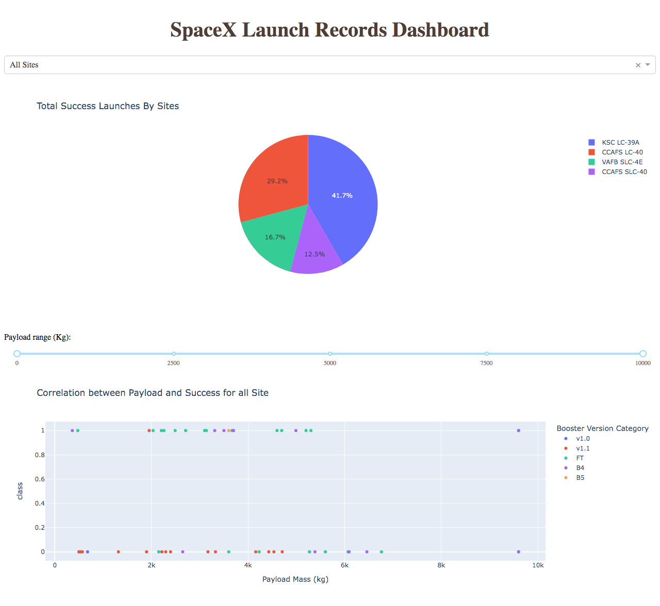
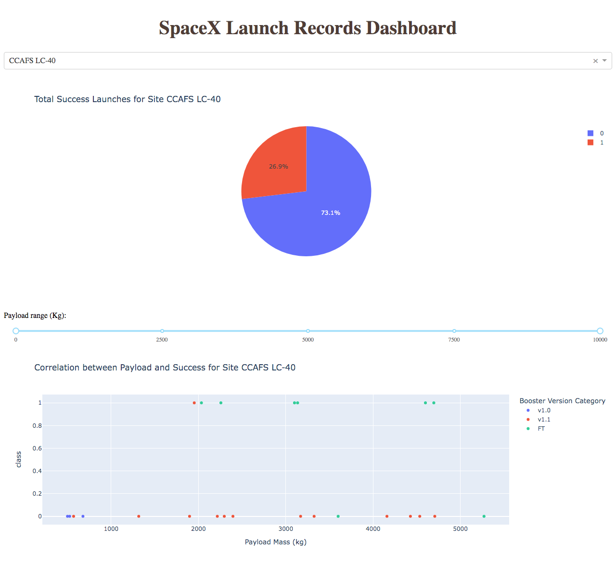
Screenshots for the interactive analytics dashboard

Slide 18
Results
Predictive analysis results- All the models performed well with almost equal accuracy of~83% on the test data, however Decision tree model performed marginally better on training data set compared to other classification models.

Slide 19


Slide 20
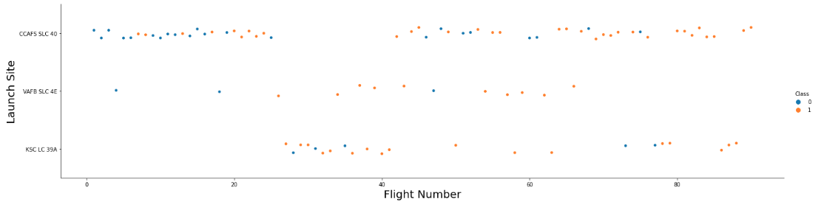
Flight Number vs. Launch Site
From the above graph it is clear that 90% of Initial flights were launched from site CCAFS SLC 40
Fewest launches took place from the site VAFB SLC 4E

Slide 21
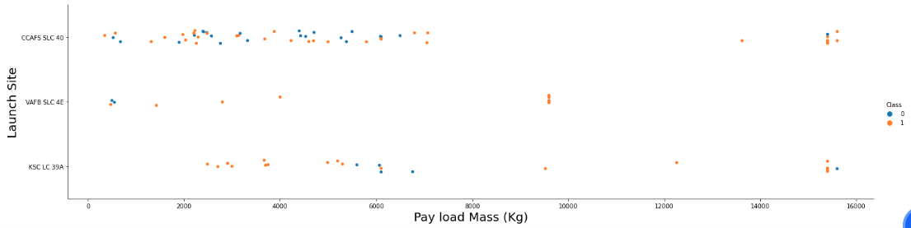
Payload vs. Launch Site
Show a scatter plot of Payload vs. Launch Site
Show the screenshot of the scatter plot with xplanations
From the above graph it is clear that no rockets launched for heavy payload mass (greater than 10,000 kg) at site VAFB SLC 4E
Majority of launches with payload mass greater than 8,000 kg have been successful.

Slide 22
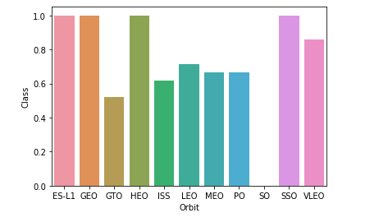
Success Rate vs. Orbit Type
ES-L1,GEO,HEO AND SSO orbits have the highest success rate of 100% whereas SO orbit has the lowest.

Slide 23
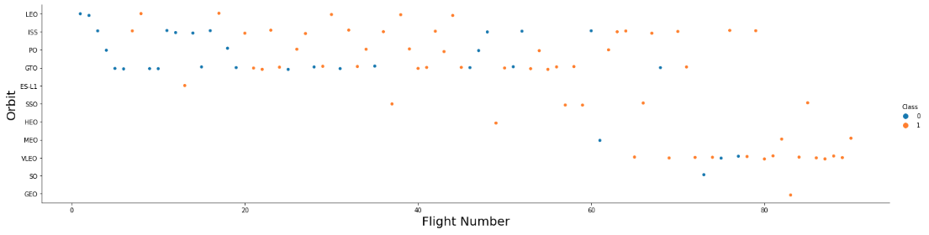
Flight Number vs. Orbit Type
You should see that in the LEO orbit the Success appears related to the number of flights; on the other hand, there seems to be no relationship between flight number when in GTO orbit

Slide 24
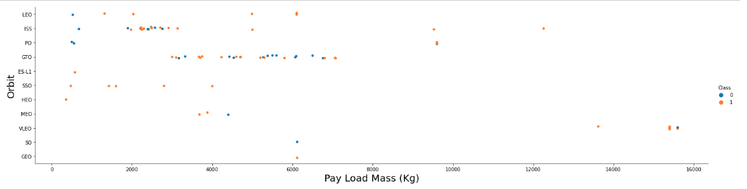
Payload vs. Orbit Type
With heavy payloads the successful landing or positive landing rate are more for Polar,LEO and ISS.
However for GTO we cannot distinguish this well as both positive landing rate and negative landing (unsuccessful mission) are both there here.

Slide 25
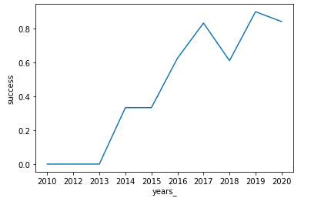
Launch Success Yearly Trend
Looking at the graph we can say that the success rate has kept on increasing since 2013 till 2020.

Slide 26
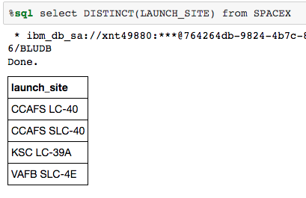
All Launch Site Names
There are four unique Launch Sites:
CCAFS LC-40
CCAFS SLC-40
KSC LC-39A
VAFB SLC-4E

Slide 27
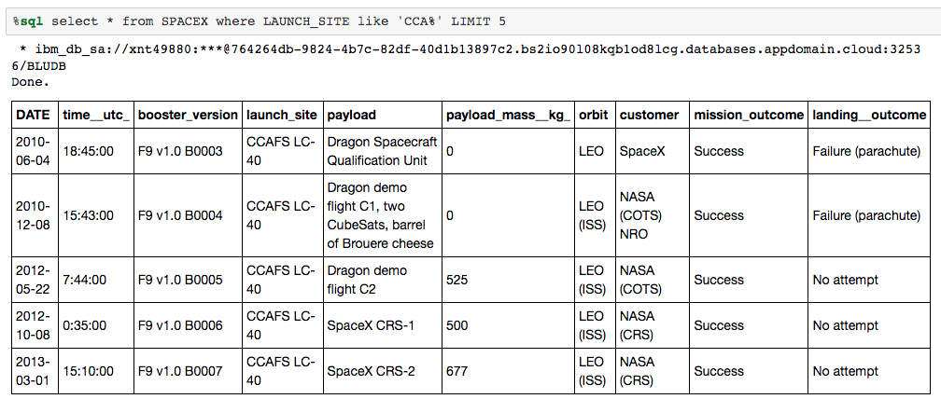
Launch Site Names Begin with 'CCA'
In the screenshot below you can see the 5 records whose launch site names begin with ‘CCA’

Slide 28
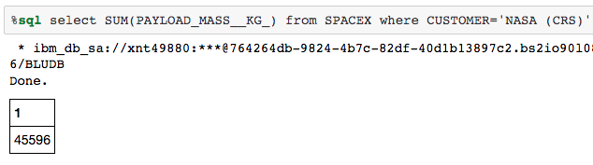
Total Payload Mass
The total payload carried by boosters from NASA is 45596 kg

Slide 29
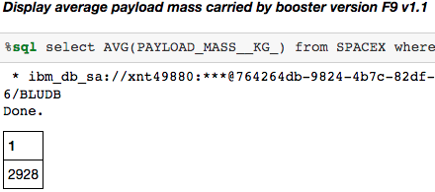
Average Payload Mass by F9 v1.1
Average payload mass carried by booster version F9 v1.1 is 2928 kg

Slide 30
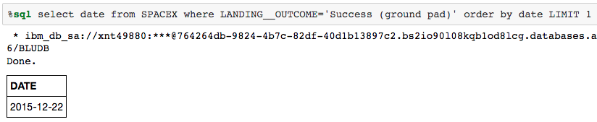
First Successful Ground Landing Date
The first successful landing outcome on ground pad was on 22, December,2015

Slide 31
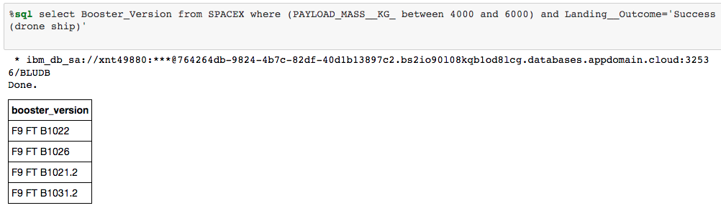
Successful Drone Ship Landing with Payload between 4000 and 6000
The names of boosters which have successfully landed on drone ship and had payload mass greater than 4000 but less than 6000 are
1. F9 FT B1021.2
2. F9 FT B1031.2
3. F9 FT B1026
4. F9 FTB1022

Slide 32
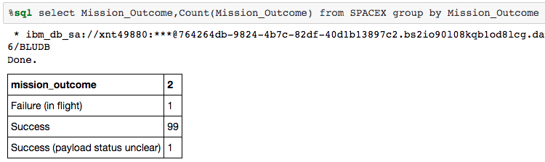
Total Number of Successful and Failure Mission Outcomes
The total number of successful and failure mission outcomes are given in the screenshot below.

Slide 33
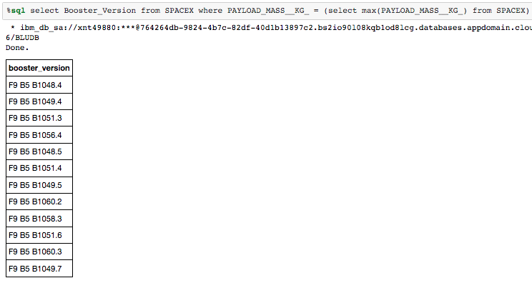
Boosters Carried Maximum Payload
Booster which have carried the maximum payload mass are as follows:
F9 B5 B1048.4
F9 B5 B1049.4
F9 B5 B1051.3
F9 B5 B1056.4
F9 B5 B1048.5
F9 B5 B1051.4
F9 B5 B1049..5
F9 B5 B1060.2
F9 B5 B1058.3
F9 B5 B1051.6
F9 B5 B1060.3
F9 B5 B1049.7

Slide 34
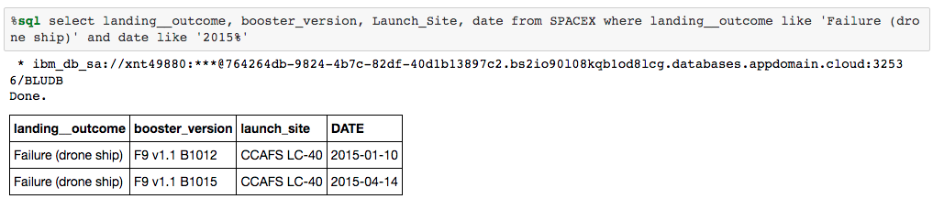
2015 Launch Records
The failed landing_outcomes in drone ship, their booster versions, and launch site names for in year 2015 are shown in the image below

Slide 35
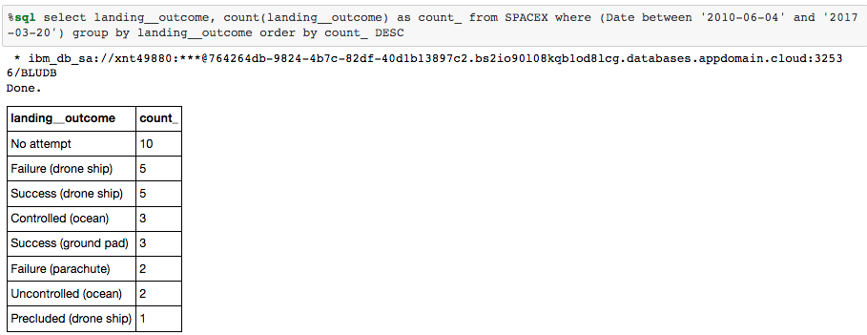
Rank Landing Outcomes Between 2010-06-04 and 2017-03-20
Rank the count of landing outcomes (such as Failure (drone ship) or Success (ground pad)) between the date 2010-06-04 and 2017-03-20, in descending order

Slide 36


Slide 37
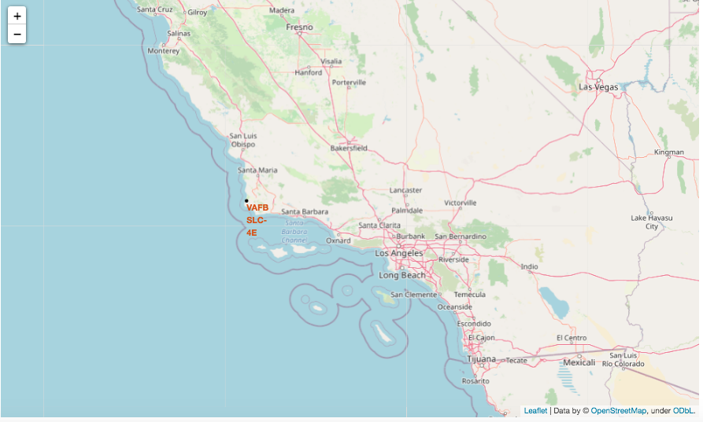
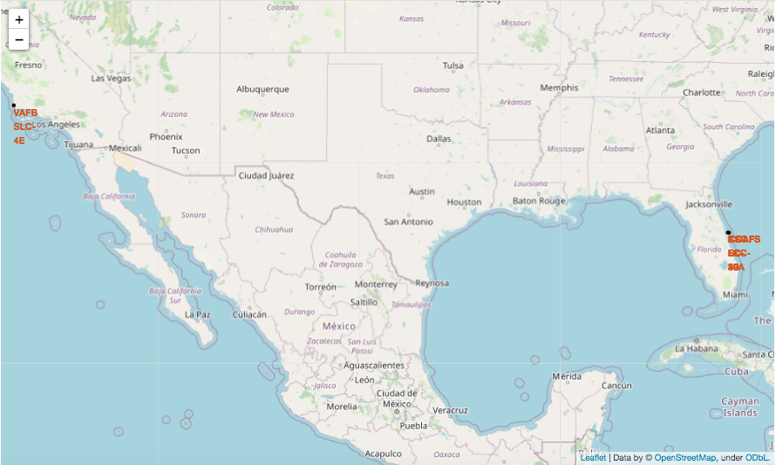
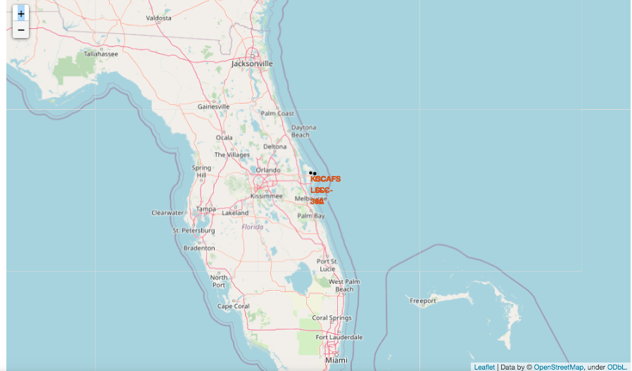
Launch sites’ location markers on global map

Slide 38
Launch sites’ location markers on global map
After looking at the launch sites’ locations on the global map one can say that all the four launch sites are very near to the sea coast.
Also all the four launch sites are in close proximity to the equator

Slide 39
The success and failed launches for each site marked on the map
In the following slide you’ll be seeing different sites marked on the map with launched outcomes.
Successful launches have been marked in ‘green’ and failed launches have been marked with ‘red’.
Looking at the maps it is clear to say that one can easily identify which sites have relatively high success rates and which sites are used for frequent launches.

Slide 40
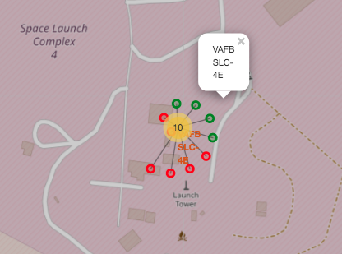
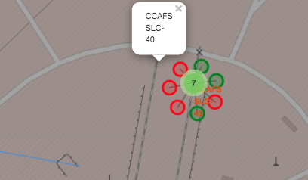
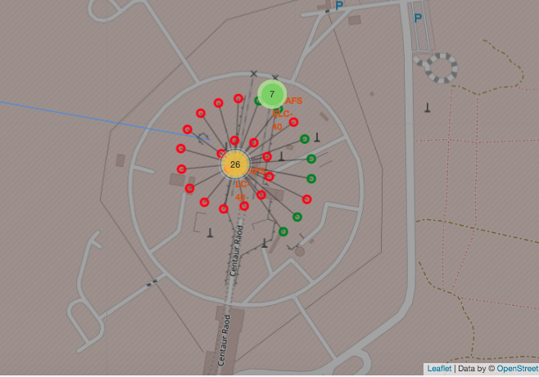
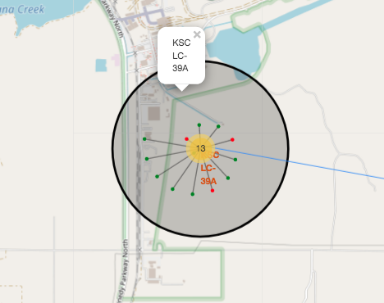

Slide 41
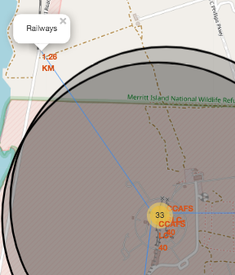
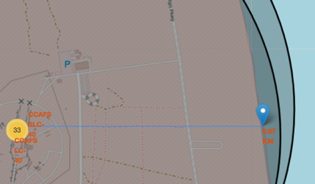
CCAFS SLC-40 in proximity to coastline, railway, city and highway
Looking at the screenshots of the map with launch site ‘CCAFS SLC-40’ marked in proximity to railways, highways, city and coast(, one can clearly say that the launch site is usually in close proximity to coast (~1km), railways(~1.3 km) and highways(~0.70 km) but far away from the closest city CAPE CANAVERAL ( ~ 19km)

Slide 42
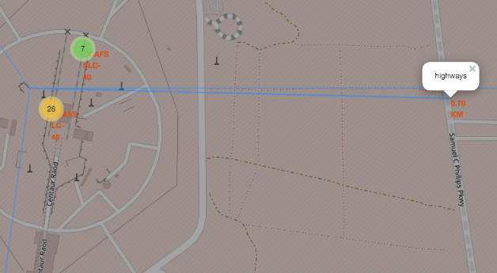
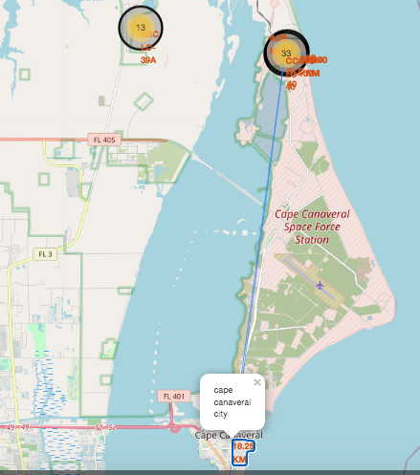
CCAFS SLC-40 in proximity to coastline, railway, city and highway

Slide 43


Slide 44
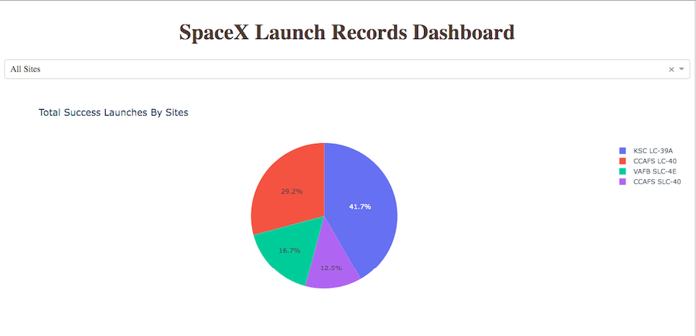
Launch success count for all sites on Plotly dash
After looking at the pie chart above we can clearly identify that site KSC LC-3940 has the largest and highest successful launches among all sites.

Slide 45
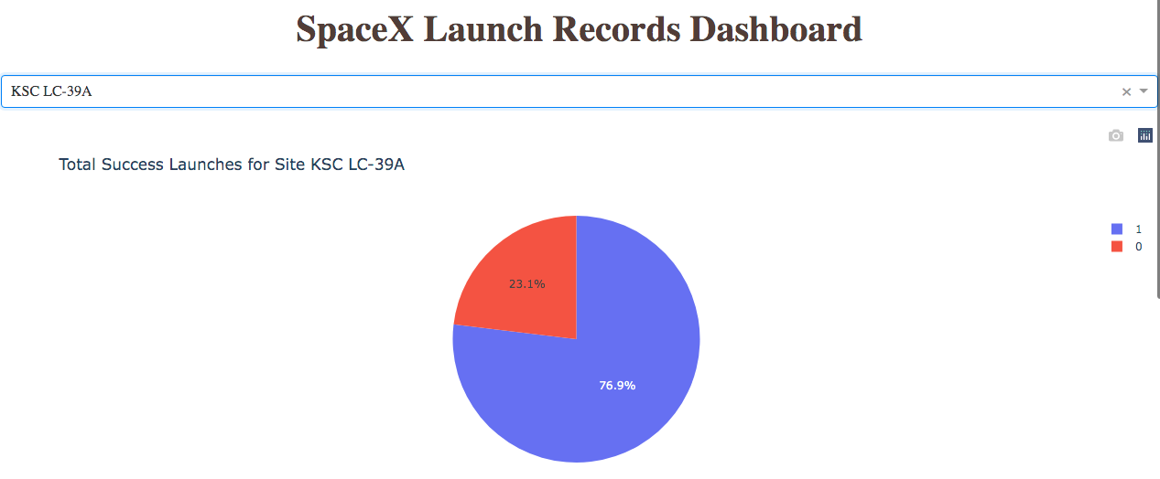
Launch Site with the highest launch Success Ratio
Total Success Launches for the site ‘KSC LC-39A’ with highest success ratio out of all the launch sites can be seen above. The launch site has the success percentage of ~77%.

Slide 46
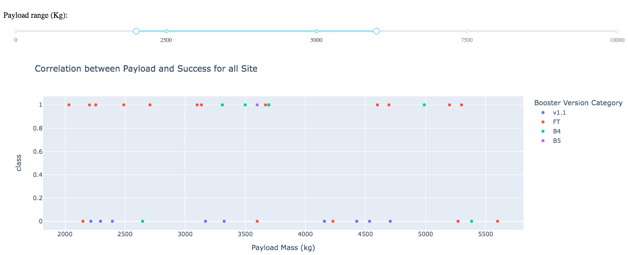
Payload v.s Launch Outcome via interactive dashboard
We can clearly see that payload range between 2000-5500kg have the highest successful launches.

Slide 47
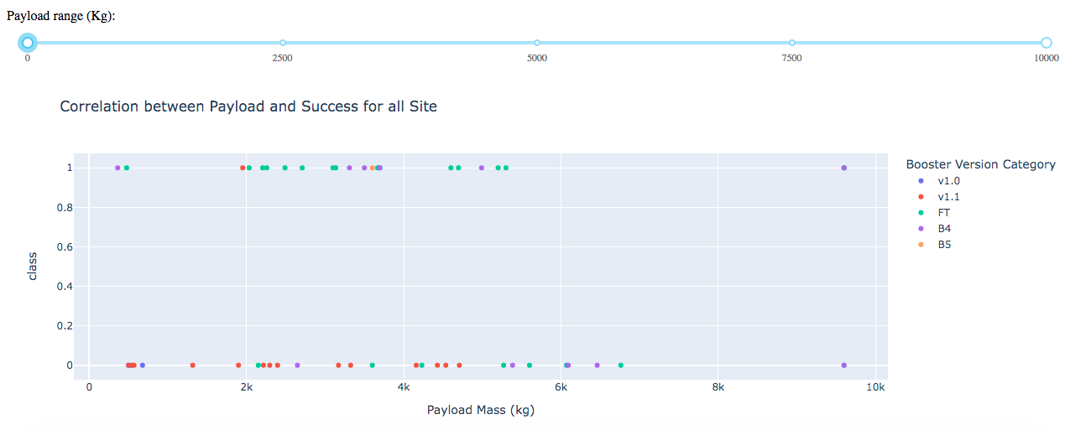
Payload v.s Launch Outcome via interactive dashboard
Looking at the above scatter plot we can clearly say that Booster Version ‘FT’ has the best success rate.
Launch success rate decreases drastically with an increase in payload mass between 6000kg and 10000kg

Slide 48
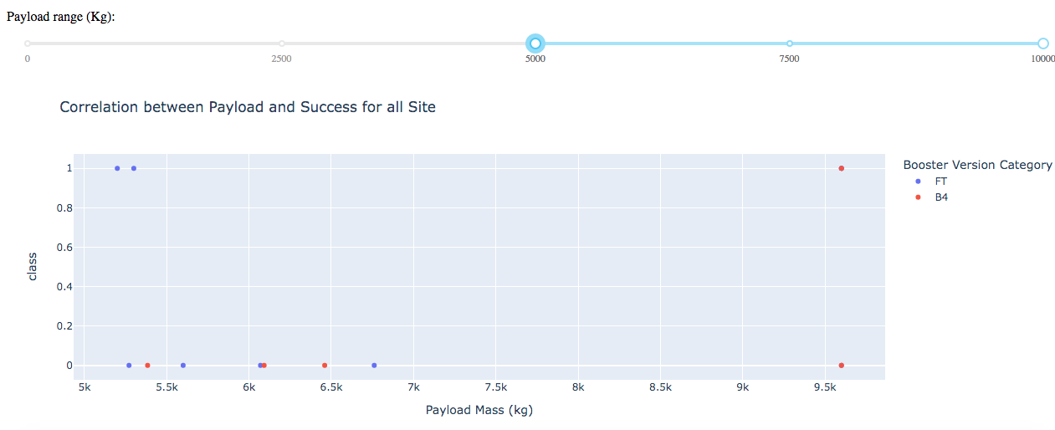
Payload v.s Launch Outcome via interactive dashboard
Booster version ‘B4’ has carried the maximum payload mass of ~9600kg

Slide 49


Slide 50
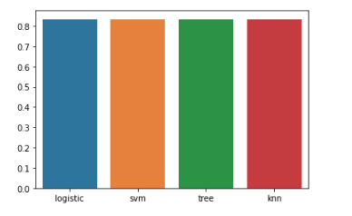
Classification Accuracy
The following bar chart shows the accuracy for the different classification models we built.
It can be seen that all the classification models had same accuracy ~83% on the test data set.
However decision tree model had marginally better train data accuracy with accuracy ~89%

Slide 51
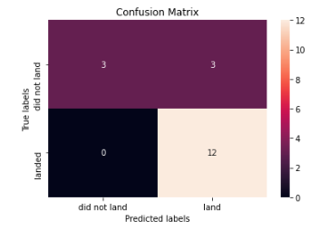
Confusion Matrix
All the models had exactly the same confusion matrix, plotting the decision tree confusion matrix below as it has the best in sample accuracy along with best out of sample accuracy.
Examining the confusion matrix, we see that Decision Tree can distinguish between the different classes. We see that the major problem is false positives.

Slide 52
Conclusions
Launch site should be near equator and in close proximity to the sea coast and away from a city.(densely populated areas)
Rocket landing success was highest when payload mass was in the range (2000-5000) kg
Booster version FT has the best success rate.
The decision tree classification model that we built can predict whether the first stage of falcon 9 rocket will land successfully with an accuracy of ~83%

Slide 53
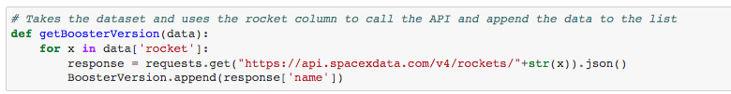
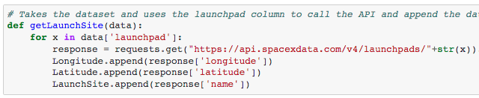
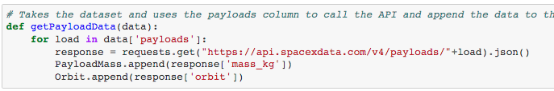
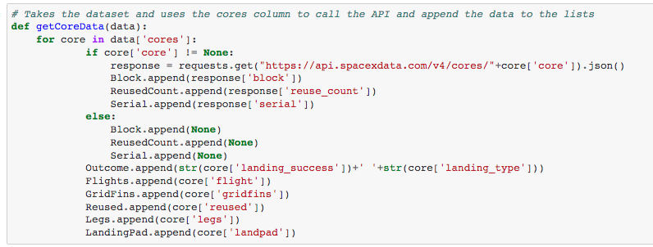
Appendix
Functions used to extract column names in collecting data from SpaceX api

Slide 54
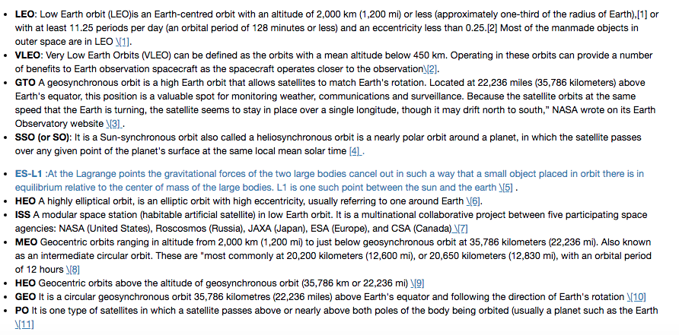
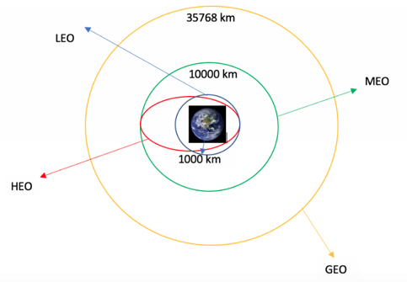
Appendix
Each launch aims to an dedicated orbit, and here are some common orbit types:

Slide 55
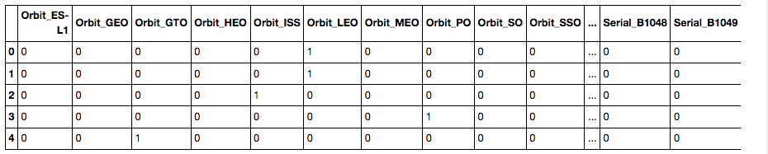
Appendix
Categorical variables converted to dummy variables.

Slide 56
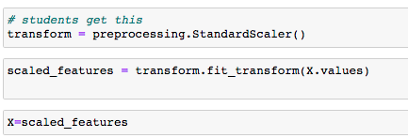
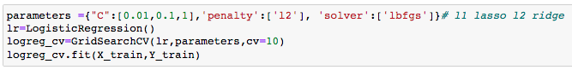
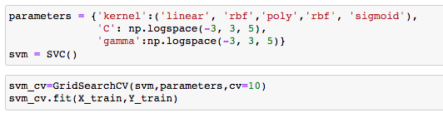
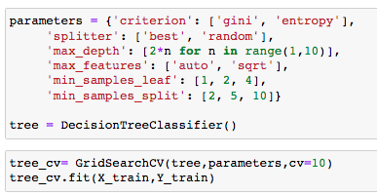
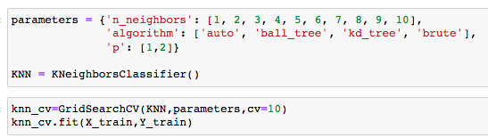
Appendix
Snippets of code for standardising data, prepare train and test data set for predictive analysis
Snippets of code for training models for predictive analysis

Slide 57


